Slide 1

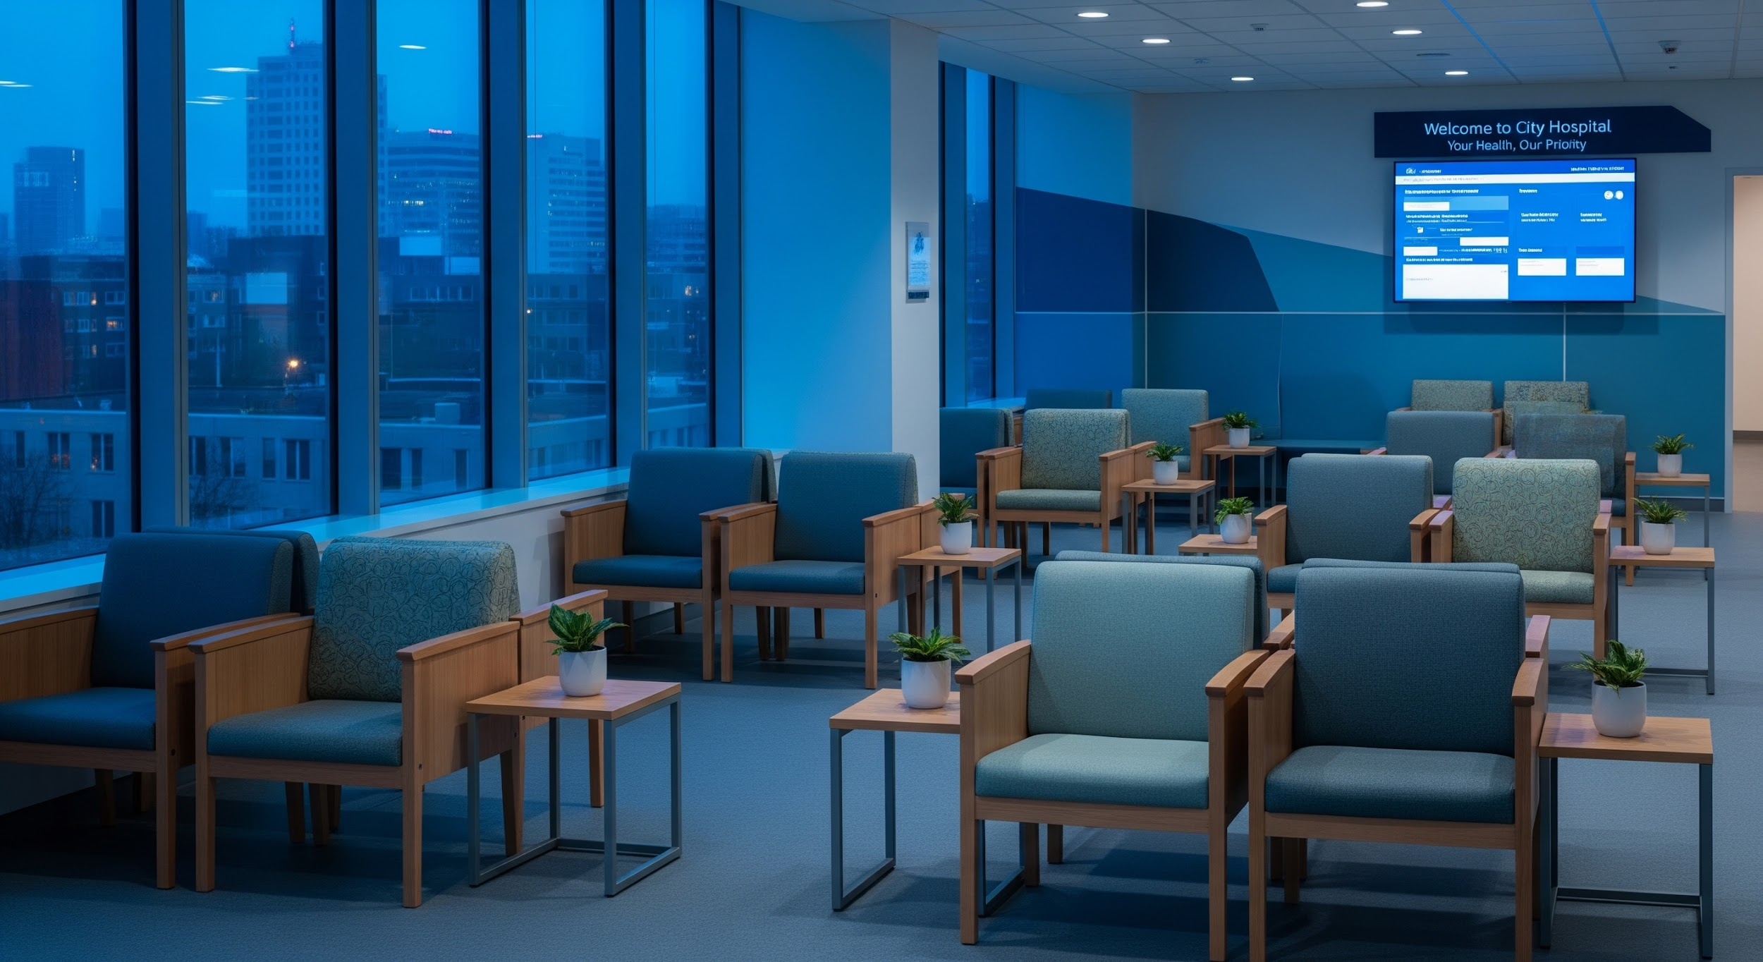
MedAssist
Patient Journey Companion
From Your Home to The Treatment Room
Roy Davidovich | Tal Ayoun Hub Workshop - 2026
Notes:
The Hook
Have you ever been to a hospital and had no idea where to go? For us, it was roy’s 80-year-old grandmother. She manages a busy schedule. She drives everywhere, runs errands, and is always the one giving orders- never asking for help. But when she arrived at the hospital for a simple eye exam, everything changed. Faced with identical corridors, confusing signs, and dozens of rushed staff members passing by without making eye contact, she felt completely lost.

Slide 2

INTRO
THE PROBLEM
THE CHALLENGE
THE SOLUTION
Modern hospitals are medical marvels but logistical nightmares. Overwhelmed patients, especially in emergencies, struggle with complex layouts and confusing paperwork. This cognitive barrier slows recovery, wastes staff time, and leads to costly missed appointments.
To turn a fragmented, stressful arrival into a single, guided journey that ensures the patient is ready for treatment.
A zero-install assistant that initiates contact with the patient to handle prep, paperwork, visual navigation, step-by-step directions, and motivation.
Notes:
The Problem
That morning, the hospital wasted a valuable specialist appointment. A nurse had to stop her clinical work just to act as an information desk. This happens hundreds of times a day. Instead of managing the event, the system drops the patient into what we call the 'Black Hole': waiting in front of a closed door, with zero information and absolutely no sense of control. And this Black Hole translates directly into numbers. An average hospital burns 4,500 staff hours a year guiding lost patients, losing over half a million dollars annually.
In the US alone, patient no-shows cost the healthcare system $150 billion a year. And in most cases, the reason is simple: the patient just didn't understand what was required of them, or gave up because the journey was simply too complicated.
The Solution
Our solution is MedAssist. It is a zero-friction, web-app patient companion. There is no app to download and no passwords to remember, patients just get an SMS link.
Days before the procedure, the link provides exact preparation instructions to prevent no-shows. On the day of the visit, it uses one-image-per-screen photo navigation, effortlessly overcoming language and age barriers. When the patient sits down, the screen updates in real-time, letting them know the staff is aware they arrived.
Our Vision
Our vision at MedAssist has three core goals: - Patients arrive for treatment calm and prepared. - The medical staff stops acting as a human information desk and returns to providing care. - And the next time Roy's grandmother visits the hospital, she won't have to give up and go home just because no one stopped to tell her she was exactly in the right place.

Slide 3









One SMS. The entire visit, handled.
1. SMS Link
2. Prepare
3. Visit
No app to download, no accounts, no passwords. Just a secure link sent directly to the patient.
A step-by-step checklist from home. Fasting instructions, what to bring, and digital forms.
In-hospital photo navigation and a live waiting-room status screen updated in real-time.
Notes:
As Tal mentioned earlier, our entire philosophy is zero friction. Here is how that translates into our architecture.
Everything is orchestrated through one SMS link that acts as a dynamic timeline.
Days before the visit, it opens the 'Prepare' phase- handling digital forms and fasting instructions from home.
On the actual day of the appointment, that exact same link dynamically updates to become their 'Visit' companion, giving them live navigation and queue status.
After their arrival to the hospital, instead of confusing signs, the system speaks in visual language. One image and one sentence per screen, guiding them step by step to the right department. This visual navigation is a strategic choice- it immediately removes barriers of age, language, and over complicating technology.

Slide 4
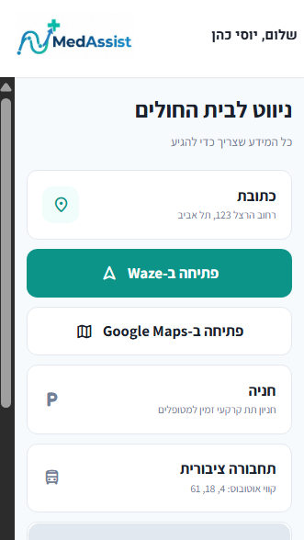
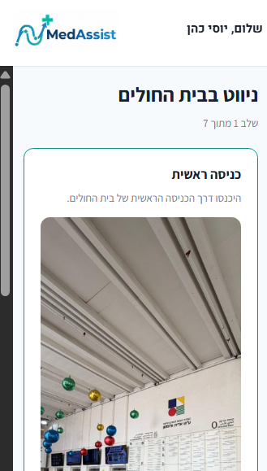
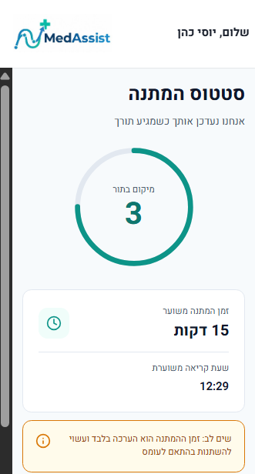
The Black Hole
Two problems no existing solution has solved end-to-end.
Visual Navigation
Live Waiting Screen
Notes:
To solve the 'Black Hole’ we mentioned earlier, we built two main engines.
First, our Visual Navigation engine. Instead of relying on indoor GPS algorithms which are notoriously inaccurate, our database maps out routes as sequential landmark nodes. The UI simply renders the correct media asset for each step.
Second, the Live Waiting Screen. Our frontend continuously syncs with the backend queue state. The moment a staff member updates a department's status, the patient's session reflects their exact position and estimated wait time in real-time, without them ever needing to refresh the page.
One deliberate constraint: the time shown is a rough estimate only. Our user research and hospital staff interviews made clear that precise times create frustration the moment reality come knocking in- emergencies jump the queue, tests run long. Since MedAssist doesn't plug into hospital internal systems, we calculate a ballpark figure from scheduled appointment windows and give Backoffice staff a broadcast action to push a delay update to all waiting patients in the department at once in case of a department delay.

Slide 5
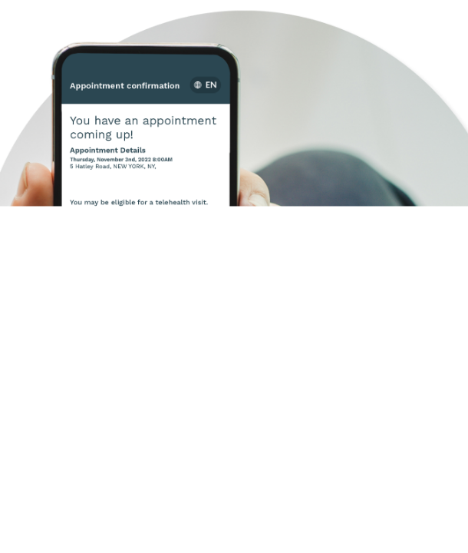

Patient View
The MedAssist Experience
Now let's switch to the live prototype to show
SMS Notification
Preparation Checklist
Landmark Navigation
Live Queue Status

Slide 6

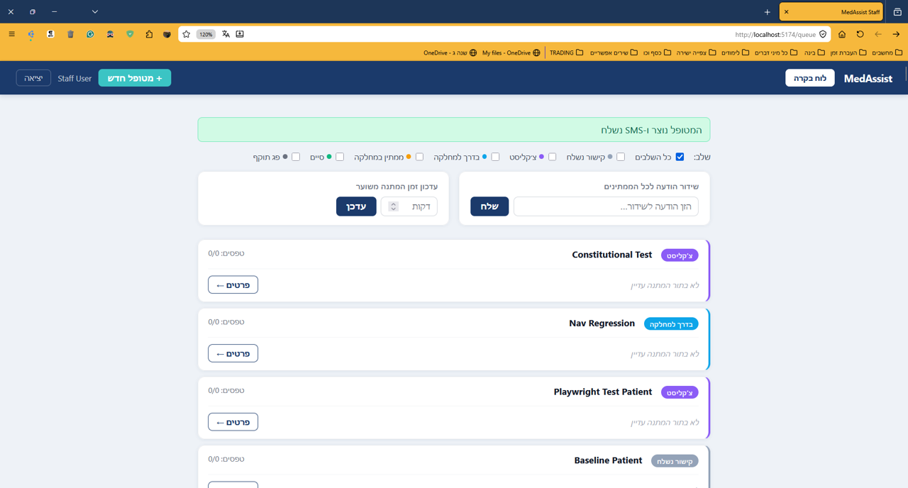
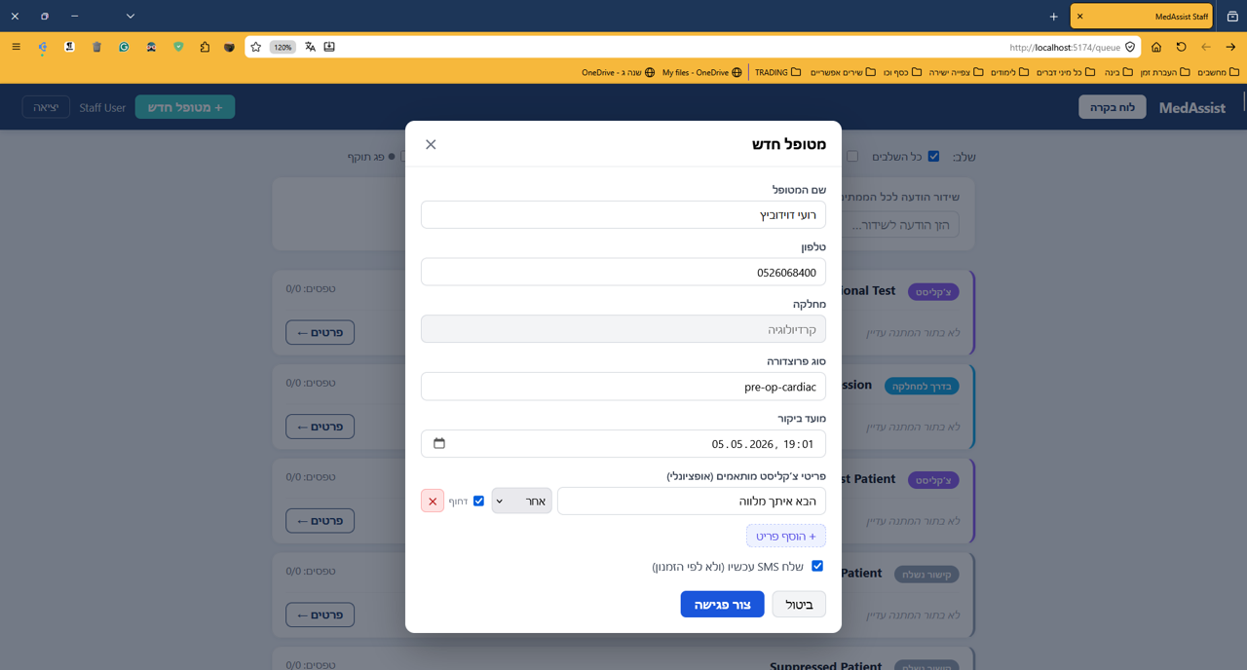
Staff View Real-Time Department Dashboard
Complete Visibility: A nurse or receptionist sees every patient currently in their department.
Phase Tracking: Instantly know who is preparing, navigating, waiting, or in treatment.
Mass Broadcasts: If there's a delay, staff can broadcast a message to all waiting patients at once.
Notes:
On the other side of the system is the staff dashboard. A nurse or receptionist sees every patient currently in their department: their name, their current phase - preparing, navigating, waiting, in treatment - and how long they've been waiting.
Status updates are one tap. If there's a delay, staff broadcast a message to all waiting patients at once - it appears immediately on every patient's screen.
For emergency patients who weren't scheduled in advance, staff generate an instant link that skips straight to the waiting screen.

Slide 7
Notes:
On the other side of the system is the staff dashboard. A nurse or receptionist sees every patient currently in their department: their name, their current phase - preparing, navigating, waiting, in treatment - and how long they've been waiting.
Status updates are one tap. If there's a delay, staff broadcast a message to all waiting patients at once - it appears immediately on every patient's screen.
For emergency patients who weren't scheduled in advance, staff generate an instant link that skips straight to the waiting screen.

Slide 8
Notes:
On the other side of the system is the staff dashboard. A nurse or receptionist sees every patient currently in their department: their name, their current phase - preparing, navigating, waiting, in treatment - and how long they've been waiting.
Status updates are one tap. If there's a delay, staff broadcast a message to all waiting patients at once - it appears immediately on every patient's screen.
For emergency patients who weren't scheduled in advance, staff generate an instant link that skips straight to the waiting screen.

Slide 9
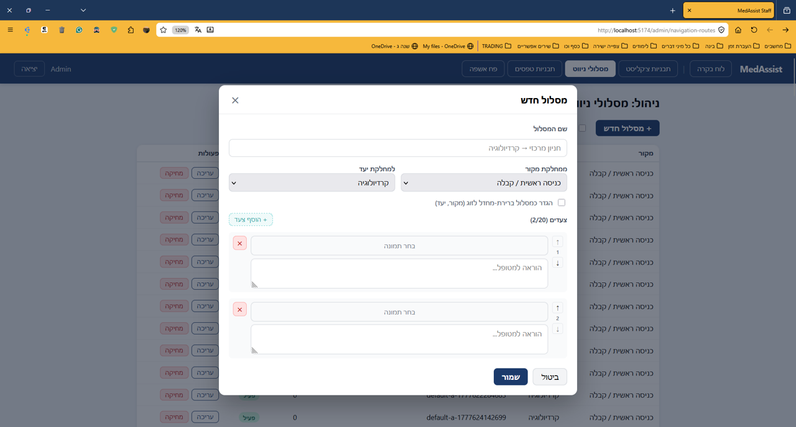
No-Code Configuration by Admins
Zero Code Required: Hospital administrators configure everything through a simple back-office panel.
Dynamic Routing: Upload navigation photos for each department and create new routes easily.
Custom Rules: Build procedure-specific checklists and set SMS delivery timelines (e.g., 24h vs 72h prior).
Notes:
Crucially, we employ Privacy by Design: no clinical or sensitive medical records are stored on our servers, ensuring full compliance with Israeli Privacy Laws and GDPR (General Data Protection Regulation).
Hospital administrators configure everything through a back-office panel - no developers needed. They upload navigation photos for each department, build procedure-specific checklists, manage form templates, and set exactly how many days before each procedure the SMS goes out.
New department? New checklist? Done in minutes, not months.

Slide 10
Notes:
On the other side of the system is the staff dashboard. A nurse or receptionist sees every patient currently in their department: their name, their current phase - preparing, navigating, waiting, in treatment - and how long they've been waiting.
Status updates are one tap. If there's a delay, staff broadcast a message to all waiting patients at once - it appears immediately on every patient's screen.
For emergency patients who weren't scheduled in advance, staff generate an instant link that skips straight to the waiting screen.

Slide 11

Status & Roadmap
Currently Completed
What's Next
Backoffice Fully functional (Local Environment)
Frontend Implementation: Migrating the patient web app from Figma to production
Patient Web App: Interactive prototype (Figma)
SMS Gateway Integration: Migrating from Telegram to SMS provider.
Messaging Service: Live integration via Telegram API
Clinical Pilot: Validation study with actual hospital staff and patients.

Slide 12
Thank You For Listening
Roy Davidovich | Tal Ayoun Hub Workshop - 2026

